Slide 1
Week 7 Recitation
Number System & Data
Rifat Bin Rashid
Teaching Assistant
Dept. of ECE, Rutgers University

Slide 2
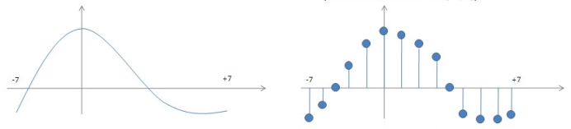
Continuous vs Discrete
Continuous Variable
Continuous in time
Continuous in value
Discrete Variable
Discrete in time
Discrete in value
Sampling
Quantization

Slide 3
Number Systems
Two types of number systems:
Non-positional number system
Positional number system

Slide 4
Positional Number Systems
Characteristics:
Use only a few symbols called digits
These symbols represent different values depending on the position they occupy in the number
The value of each digit is determined by:
1. The digit itself
2. The position of the digit in the number
3. The radix/base of the number system

Slide 5
Positional Number Systems
Base: Total number of digits in the number system
The maximum value of a single digit is always equal to one less than the value of the base
Commonly Occurring Bases:
Name
Base
Digits
Binary
2
0,1
Octal
8
0,1,2,3,4,5,6,7
Decimal
10
0,1,2,3,4,5,6,7,8,9
Hexadecimal
16
0,1,2,3,4,5,6,7,8,9,A,B,C,D,E,F

Slide 6
Decimal Number System
Characteristics:
A positional number system
Has total 10 symbols or digits (0, 1, 2, 3, 4, 5, 6, 7, 8, 9). Hence, its base = 10
The maximum value of a single digit is 9 (one less than the value of the base)
Each position of a digit represents a specific power of the base (10)
We use this number system in our day-to-day life

Slide 7
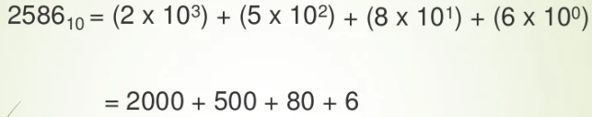
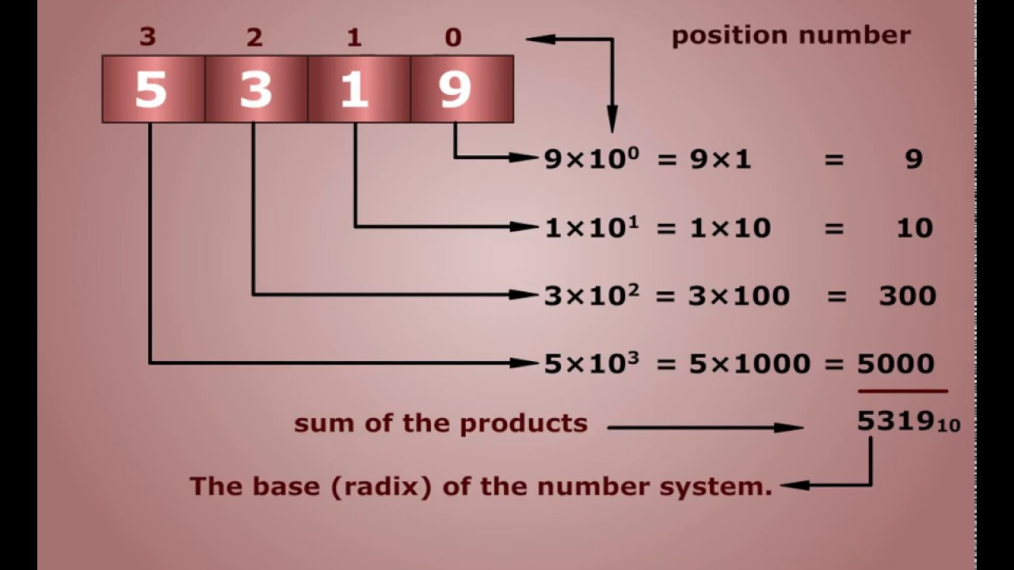
Decimal Number System
Example:

Slide 8
Binary Number System
Characteristics:
A positional number system
Has only 2 symbols or digits (0 and 1). Hence, its base = 2
The maximum value of a single digit is 1 (one less than the value of the base)
Each position of a digit represents a specific power of the base (2)
This number system is used in computers

Slide 9
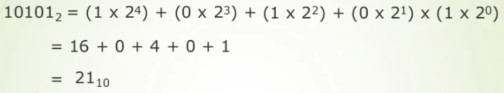
Binary Number System
Example:

Slide 10
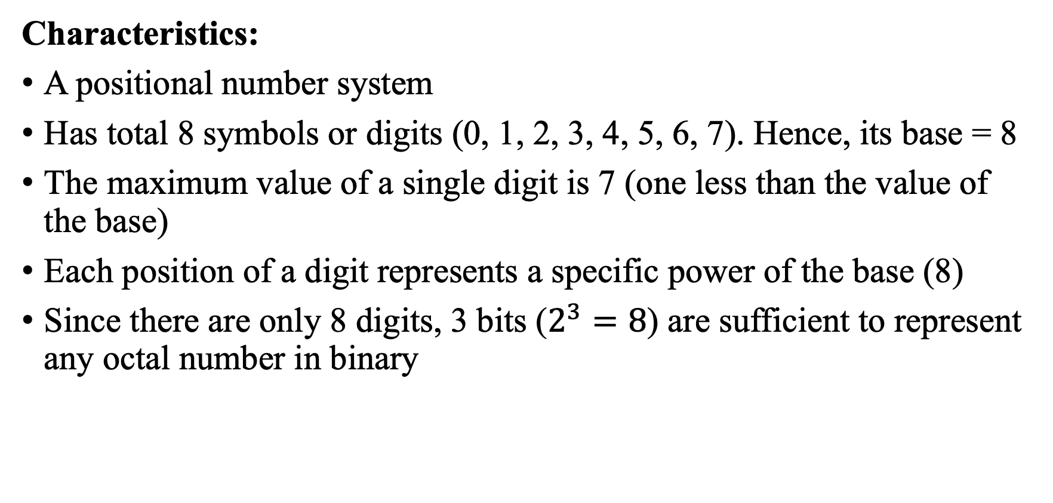
Octal Number System
Characteristics:
A positional number system
Has total 8 symbols or digits (0, 1, 2, 3, 4, 5, 6, 7). Hence, its base = 8
The maximum value of a single digit is 7 (one less than the value of the base)
Each position of a digit represents a specific power of the base (8)
Since there are only 8 digits, 3 bits ($2^{3}=8$) are sufficient to represent any octal number in binary

Slide 11
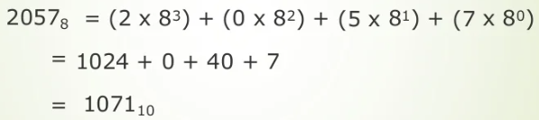
Octal Number System
Example:

Slide 12
Hexadecimal Number System
Characteristics:
A positional number system
Has total 16 symbols or digits (0, 1, 2, 3, 4, 5, 6, 7, 8, 9, A, B, C, D, E, F). Hence, its base = 16
The symbols A, B, C, D, E and F represent the decimal values 10, 11, 12, 13, 14 and 15
The maximum value of a single digit is 15 (one less than the value of the base)

Slide 13

Hexadecimal Number System
Characteristics:
Each position of a digit represents a specific power of the base (16)
Since there are only 16 digits, 4 bits ($2^{4}=8$) are sufficient to represent any hexadecimal number in binary

Slide 14
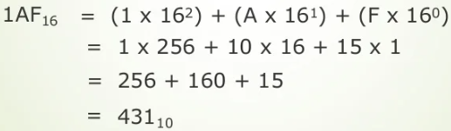
Hexadecimal Number System
Example:

Slide 15
Numbers in Different Bases
Good idea to memorize!
Decimal
Binary
Octal
Hexa
decimal
(Base 10)
(Base 2)
(Base 8)
(Base 16)
00
00000
00
00
01
00001
01
01
02
00010
02
02
03
00011
03
03
04
00100
04
04
05
00101
05
05
06
00110
06
06
07
00111
07
07
08
01000
10
08
09
01001
11
09
10
01010
12
0A
11
0101
1
13
0B
12
01100
14
0C
13
01101
15
0D
14
01110
16
0E
15
01111
17
0F
16
10000
20
10

Slide 16
Conversion Between Bases
To convert from one base to another:
1) Convert the Integer Part
2) Convert the Fraction Part
3) Join the two results with a radix point

